Slide 1
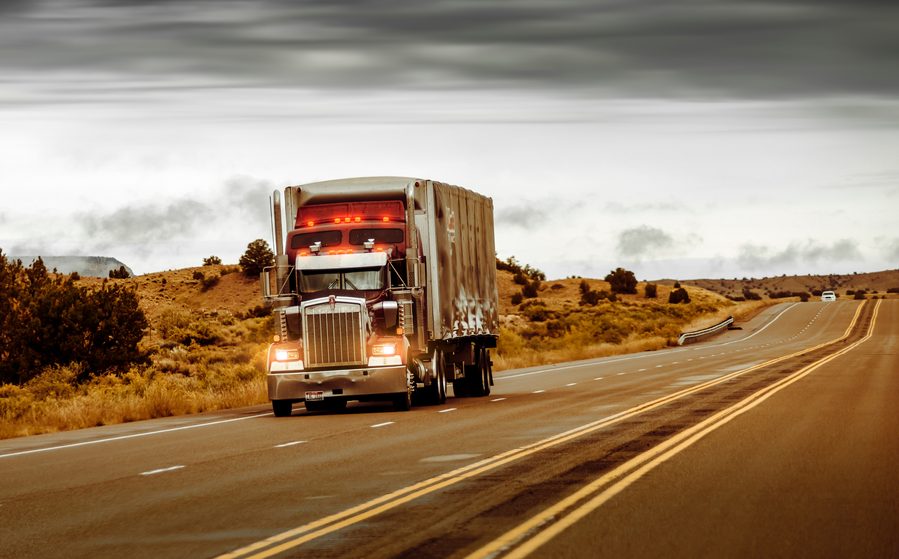
DRIVER RISK ANALYSIS AND VISUALIZATION USING BIG DATA
GROUP-1
Srinivas Ganisetti
Sai Nikhel Rangala
Nathan Le
Shreya Reddy Bommidi
Khushi Srinivas
Neel Bhavanishankar

Slide 2

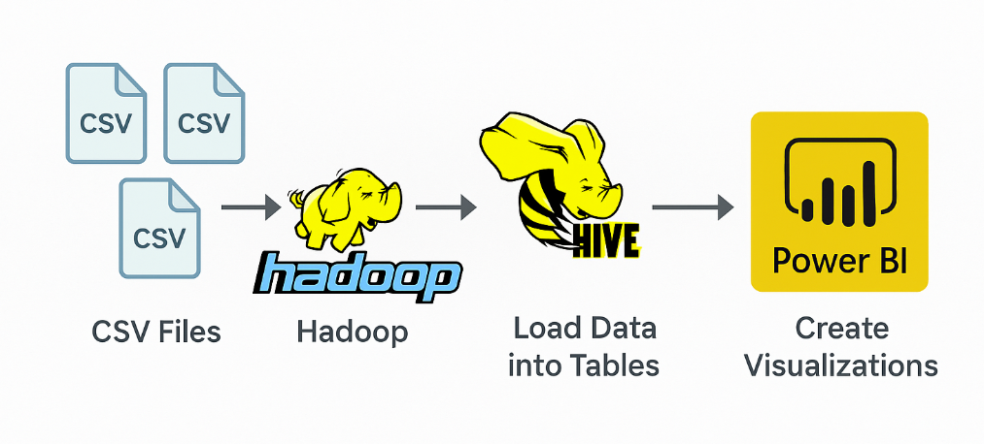
PROJECT SCOPE
The project leverages the Big Data Hadoop Ecosystem to analyze truck fleet data and identify key risk factors. The primary goal is to enhance safety protocols by enabling rapid data analysis and delivering valuable insights for decision-makers. Alongside risk factor evaluation, additional parameters such as mileage and fuel consumption are also analyzed for predictive insights.

Slide 3
STRATEGIC QUESTIONS BEHIND THE DASHBOARD
“WHICH HIGH-RISK DRIVERS HAVE THE HIGHEST ROAD EXPOSURE BASED ON TOTAL MILES DRIVEN?”
“HOW DO DRIVERS COMPARE IN TERMS OF TOTAL MILES DRIVEN AND FUEL EFFICIENCY, AND HOW DOES RISK CATEGORY INFLUENCE THIS RELATIONSHIP?”
“WHAT TYPES OF ABNORMAL DRIVING BEHAVIORS ARE MOST FREQUENT FOR THE HIGHEST RISK DRIVER?”
“WHICH CITIES EXPERIENCE THE HIGHEST NUMBER OF ABNORMAL DRIVING EVENTS?”
“WHICH TRUCK MODELS ARE ASSOCIATED WITH THE HIGHEST NUMBER OF ABNORMAL EVENTS FROM HIGH-RISK DRIVERS?”

Slide 4
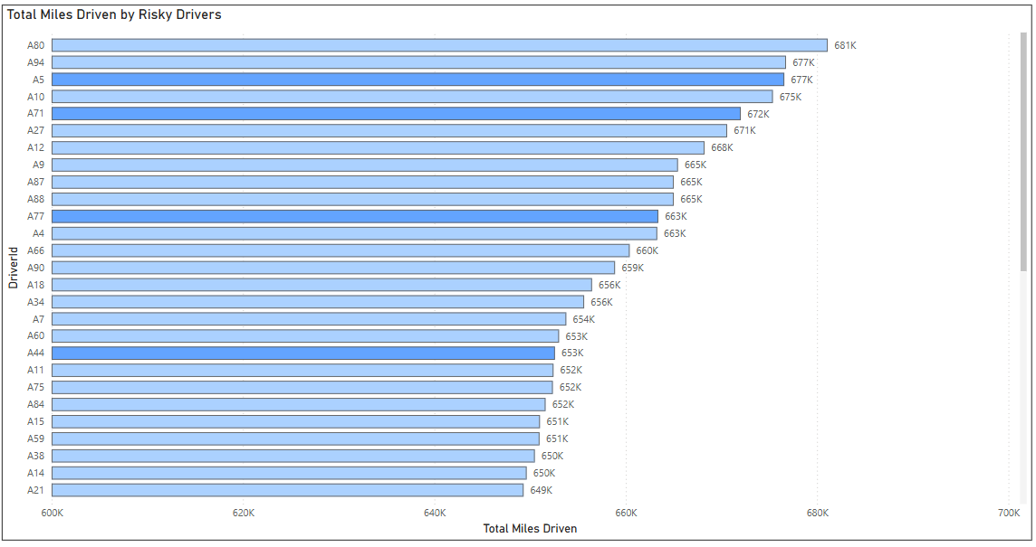

TOTAL MILES DRIVEN BY RISKY DRIVERS
Key Insights:
Drivers with risk factor ≥ 7 and significant mileage are both risk-prone and highly active.
Those at the top of the chart pose the highest operational risk due to greater exposure.
Indicates a higher potential impact on safety and cost.
Business Impact:
Enables targeted interventions like safety training.
Supports route/workload re-evaluation for high-risk drivers.
Helps prioritize actions to improve fleet safety and efficiency.

Slide 5
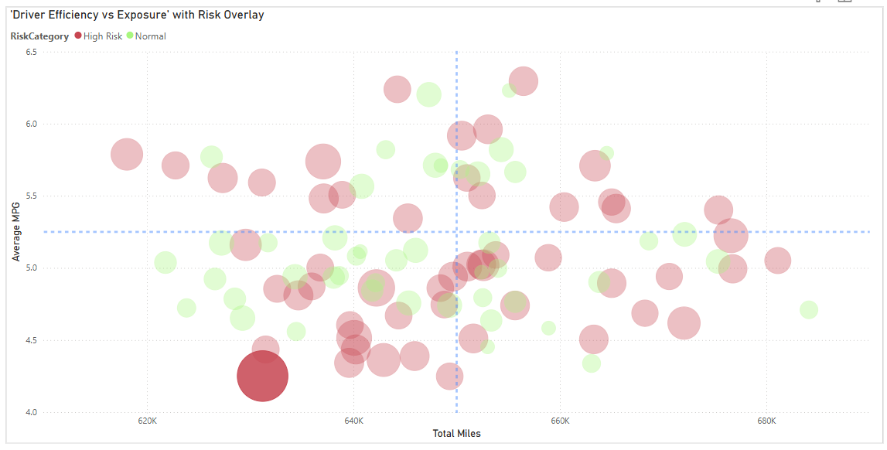
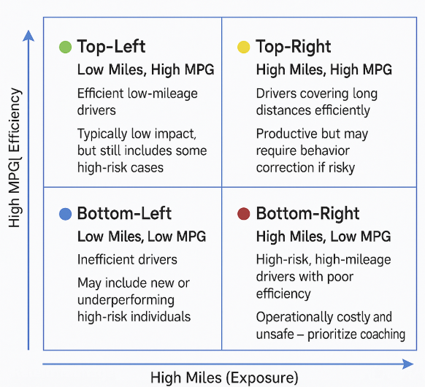
DRIVER RISK & EFFICIENCY QUADRANT WITH OUTLIER INSIGHT
THIS SCATTER PLOT VISUALIZES DRIVERS ACROSS FOUR DIMENSIONS — TOTAL MILES, FUEL EFFICIENCY (MPG), RISK FACTOR, AND RISK CATEGORY.
“NOTE THE HIGH-RISK OUTLIER IN THE BOTTOM-LEFT :
LOW MILEAGE, LOW MPG, BUT EXTREMELY HIGH RISKFACTOR”
Business Implication:
This driver may be new, but already showing red-flag behavior
Early intervention here could prevent future incidents
This kind of insight supports proactive safety strategy

Slide 6
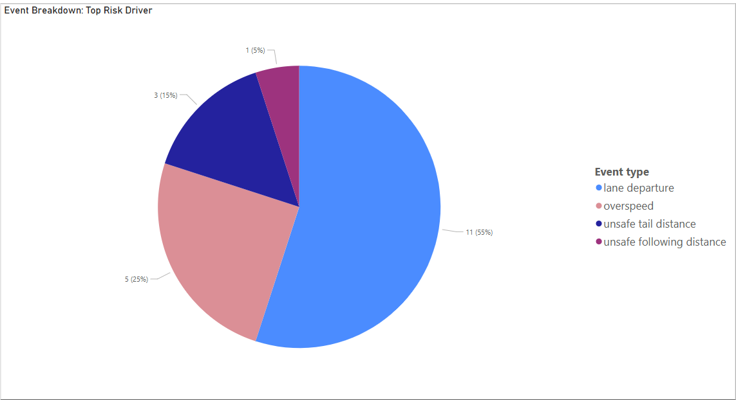
Key Insights:
Lane departure (55%) and overspeed (25%) are the most common risky behaviors.
Indicates that the driver’s risk profile is driven by lane discipline and speed violations.
Rare but critical issues like unsafe following distance are also present, showing a broad behavioral concern.
TOP RISK DRIVER:
WHAT’S CAUSING THE RISK?
Business Impact:
Enables targeted driver training on lane discipline and speed control.
Justifies personalized coaching based on behavior patterns.
Helps prioritize safety measures like lane assist alerts or speed monitoring.

Slide 7

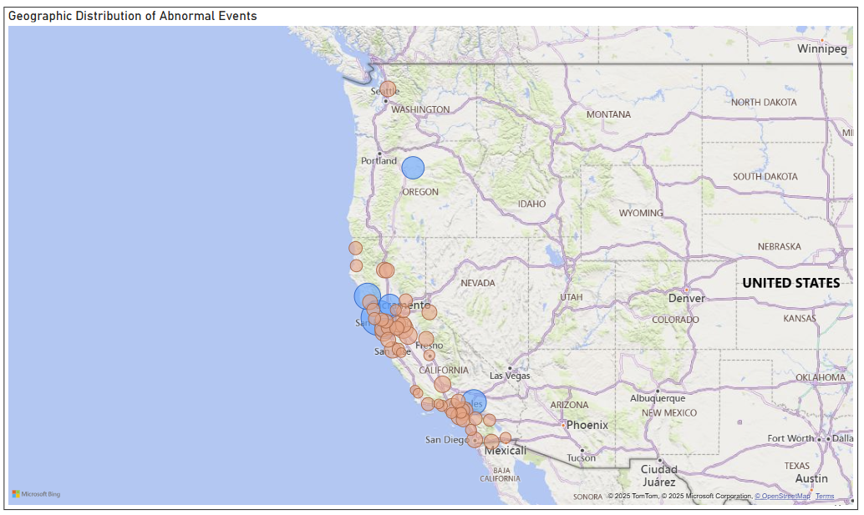
ABNORMAL EVENT CONCENTRATION BY CITY
Key Insights:
Cities with large bubbles indicate frequent driver issues, which may signal:
1. Poor road conditions
2. High-traffic urban areas
3. Route planning inefficiencies
4. Region-specific driving behavior patterns
Helps identify regional training needs, route optimizations, or policy changes

Slide 8
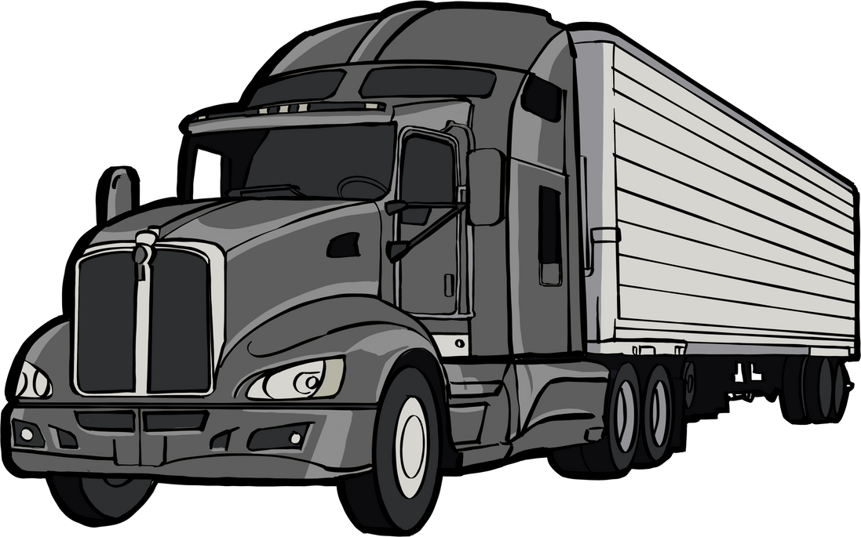
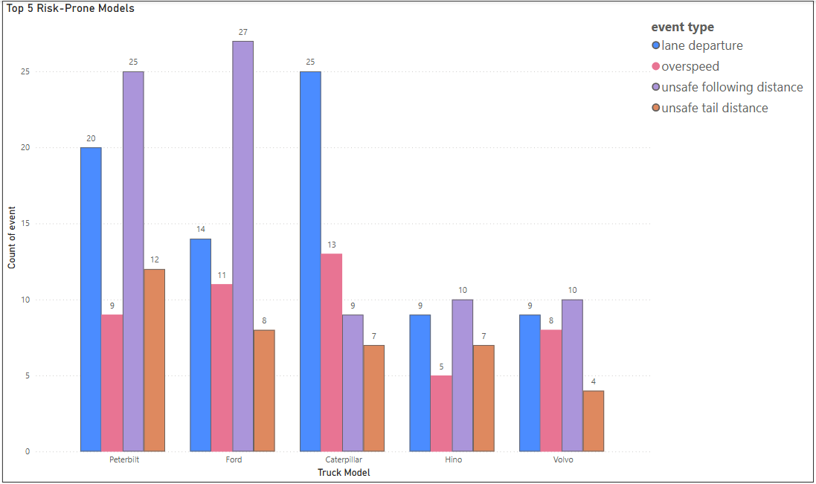
MOST RISK-PRONE TRUCK MODELS
Key Insights:
Caterpillar and ford trucks top the list with the highest number of abnormal events from high-risk drivers.
Lane departure is the most frequent event type across all five models.
Over-speeding is significantly observed in Ford and Hino, indicating aggressive driving patterns.
Even lower-volume models like Volvo and Hino show a consistent spread of risky behaviors.
Highlights the need for truck model-specific training, feature audits, or driver assignment strategies.

Slide 9
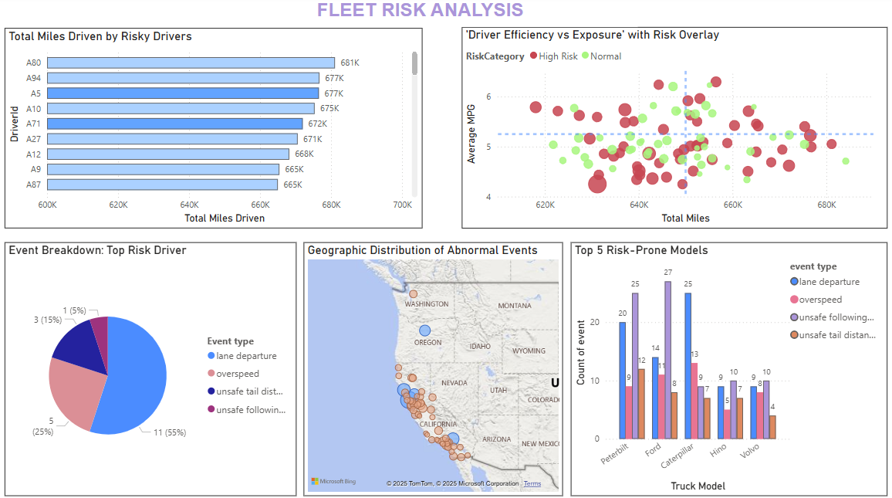

Slide 10
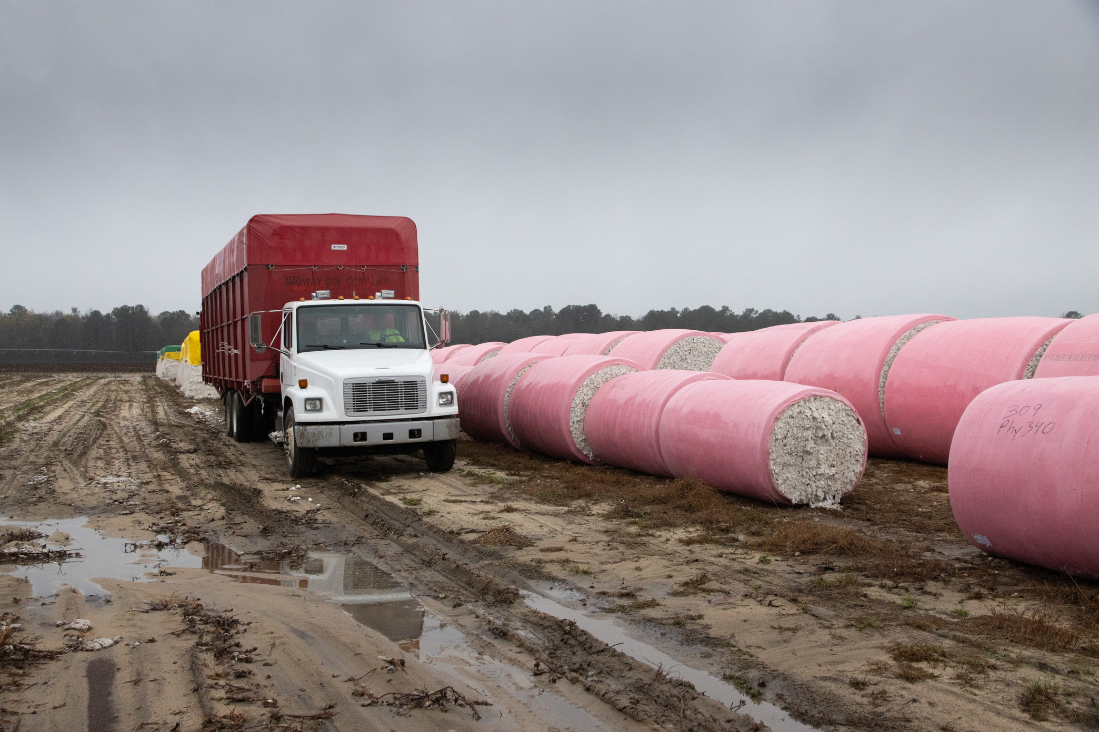
THANK YOU !
"THE GOAL IS TO TURN DATA INTO INFORMATION, AND INFORMATION INTO INSIGHT."

